Slide 1
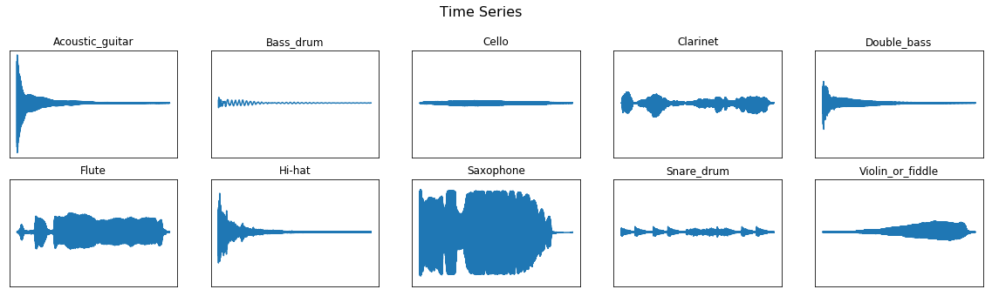
Deep Learning for Audio Classification in Python

Slide 2
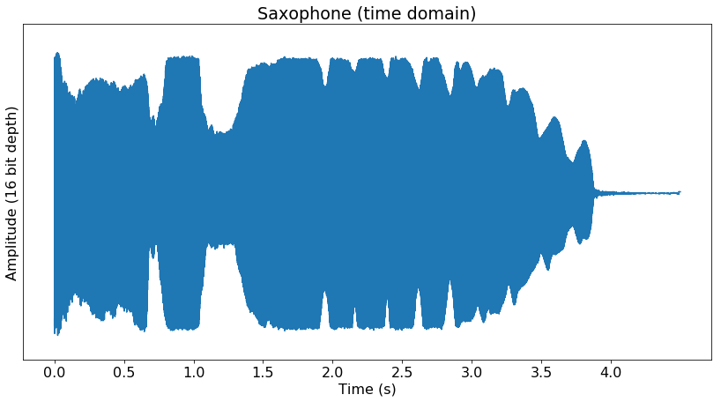
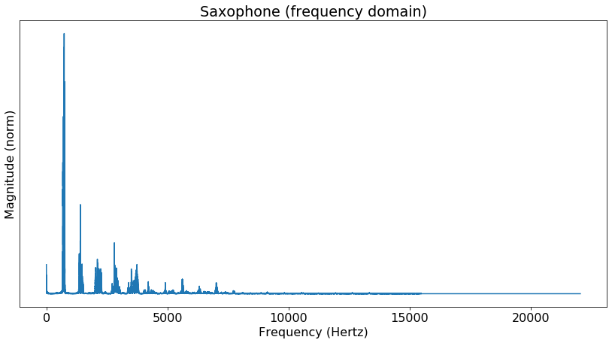
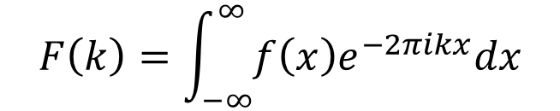
Fourier Transform
FFT
$$F\left(k\right)=\int_{−∞}^{∞}{f\left(x\right)e^{−2πikx}dx}$$

Slide 3
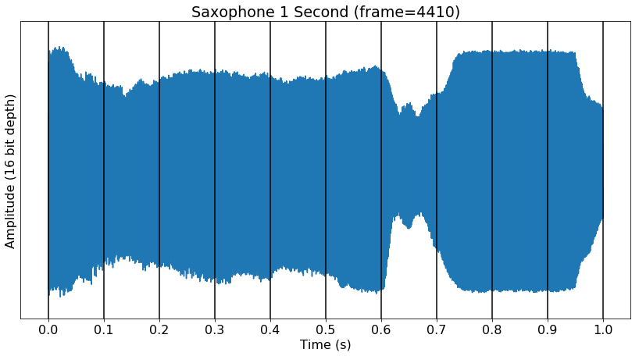
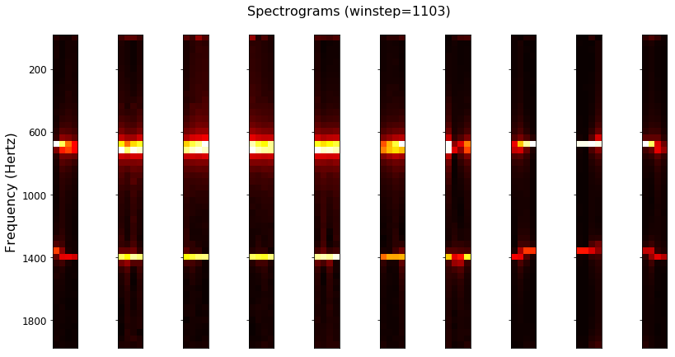
Spectrogram

Slide 4
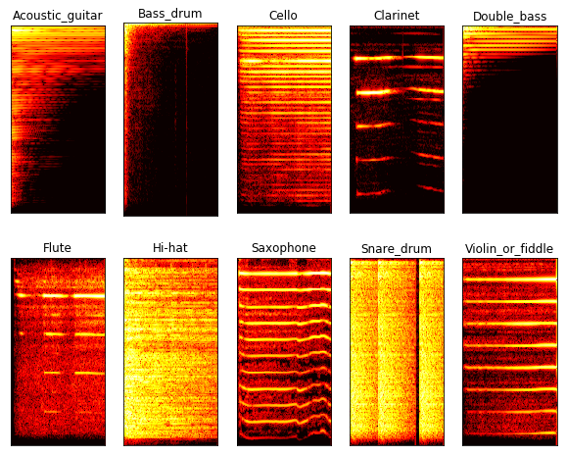
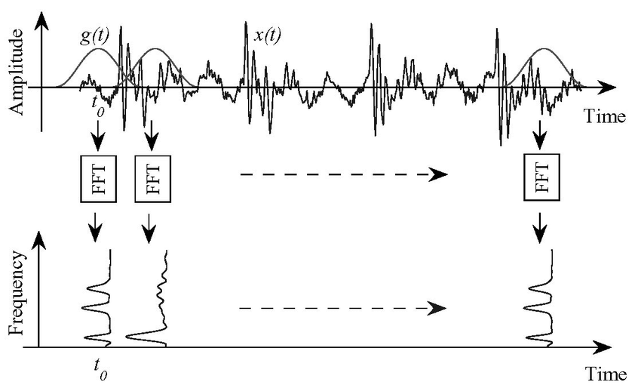
Short-Time Fourier Transform
Sampling Rate = 16 kHz
Window Length = 25 ms = 400 samples
Step Size = 10 ms = 160 samples
N FFT = 512 samples

Slide 5
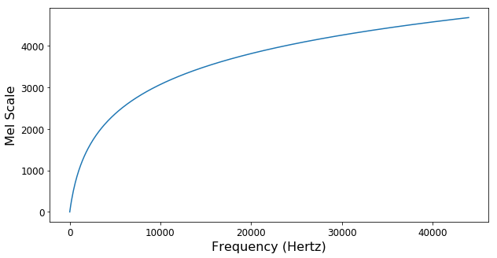
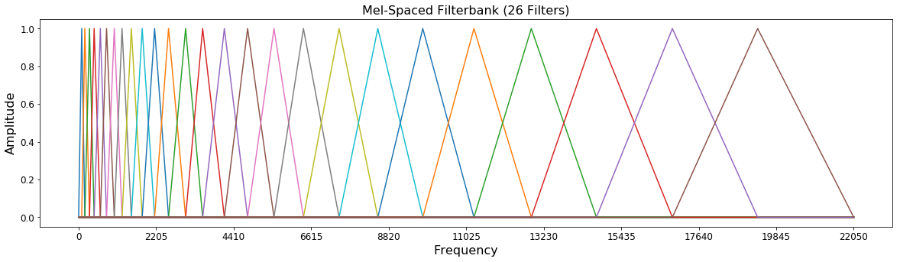
Mel Filterbank

Slide 6
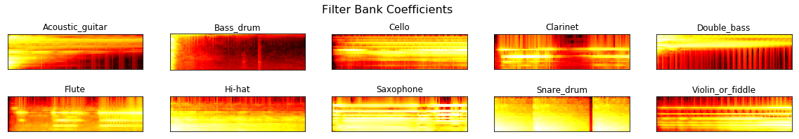
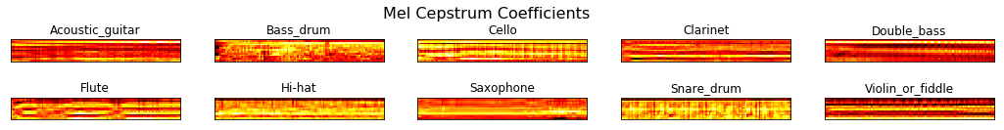
Feature Engineering (13 x 99)

Slide 7
Resources
http://practicalcryptography.com/miscellaneous/machine-learning/guide-mel-frequency-cepstral-coefficients-mfccs/
https://haythamfayek.com/2016/04/21/speech-processing-for-machine-learning.html
http://datagenetics.com/blog/november32012/index.html

